Slide 1
CS668: Capstone Project
Title: Bandcamp Analysis: Sales in the Digital Music Distribution Landscape
Name: Nguyen Nguyen
Email: nn76511n@pace.edu
Github: https://github.com/nnguyen1307/CS688_Capstone_Project

Slide 2
Research Question and Motivation
Research Question: Is it possible to identify buyer groups based on purchase amount and understanding transaction and product patterns for insights on buyer generosity through application of clustering techniques?
Motivation:
The digital music industry, led by Spotify and Apple Music, has disrupted physical music sales, affecting artist revenues. However, Bandcamp stands out by giving artists pricing autonomy and users the freedom to pay as desired.
Being an avid bandcamp user and music collector, I want to gain insights on the platform’s benefits

Slide 3
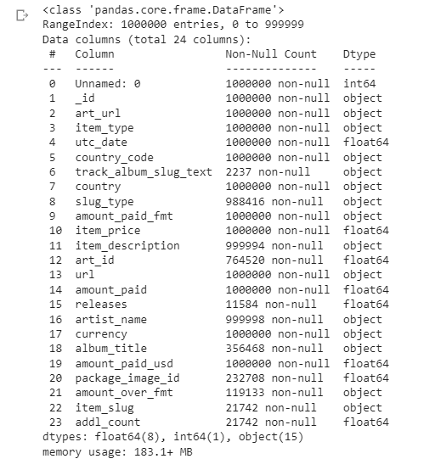
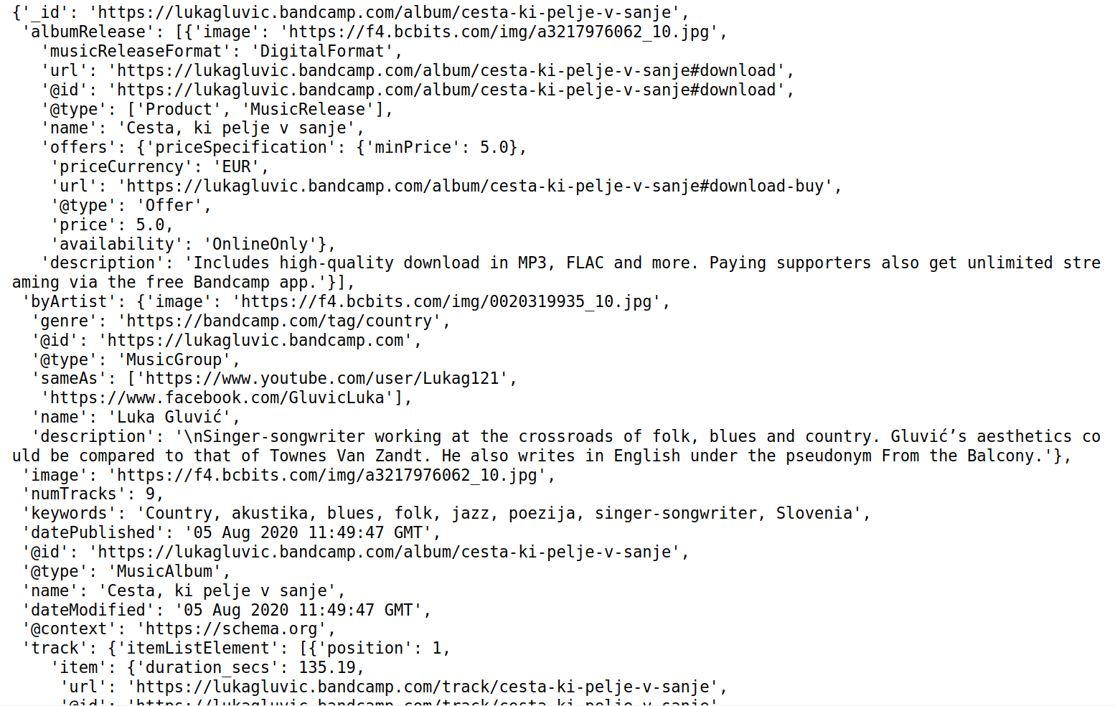
Dataset
Dataset: 1,000,000 Bandcamp sales & 1,069,972 Bandcamp items
Sales dataset contains records of 1,000,000 sales from 9/9/2020 and 10/2/2020
Items dataset contains 1,000,000+ from Bandcamp published between 08/2020 and 01/2021
Scraped from bandcamp’s main page’s sales feed and from bandcamp’s product pages
Notes:
_id - unique identifier containnig timestamp and item url
art_url - url to item artwork
item_type - type of item ('a' for digital albums, 'p' for physical item, 't' for individual tracks, 'b' for full digital discography)
utc_date - sales' timestamps
country_code - country code for where the purchase was made
track_album_slug_text - not sure, probably a description of item or message included in purchase
country - country where purchase was made
slug_type - also denotes type of item similar to item_type
item_price - price of item in seller's currency
item_description - name or description of item
art_id - id of artwork
url - link to the item
currency - buyer's currency
amount_paid - amount paid by buyer in buyer's currency
amount_paid_fmt - amount paid in the buyer's currency with currency symbol
amount_paid_usd - amount paid by buyer converted to usd
amount_over_fmt - amount voluntarily paid extra by buyer (in buyer's currency)
releases - number of releases bought when user buys the full discography (at a discount)
artist_name - artist name
album_title - title of album
package_image_id - id to image of item in case of physical item
item_slug - only has the value /album/ for some transactions involving individual tracks
addl_count - also appear whenever item_slug isn't null, possibly means buyer also buys additional tracks from that same album
keywords - music's descriptors as tags

Slide 4
Literature Review
My direction was to look for relevant works related to applying clustering techniques for market segmentation.
A lot of papers seem to prefer centering data rows on customers a lot of those use implementation of RFM model.
Digital music distribution, particularly within the do-it-
yourself (DIY) landscape, remains an understudied area
Popular choice is either 2 different stages of segmentation using k-means or using k-means in addition to a different technique (such as association algorithm or NLP)
Bandcamp emphasizes the importance of a more personal interaction between vendor and buyer so my original goal was to also incorporate NLP techniques.
Authors Referenced:
Hesmondhalgh, D., Jones, E., & Rauh, A. (2019).
Garima, H. Gulati and P. K. Singh (2015).
D. V. S. Shalini, M. Shashi and A. M. Sowjanya (2011)
R. S. Bahri, I. D. Sudirman, I. D. Utama and R. H. Susanto (2023)
hung, Phan Duy and Lien, Nguyen Thi Thuy and Ngoc, Nguyen Duc (2019)
Boyu Shen. (2021).
Jorge Fresneda, Jeremy Hui, and Chelsey Hill (2022).
Jingyi Ye. (2021)

Slide 5
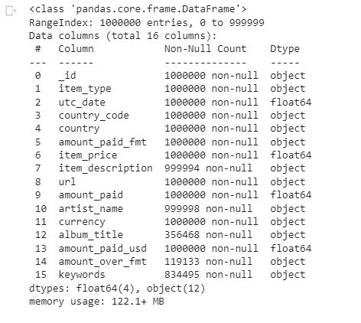
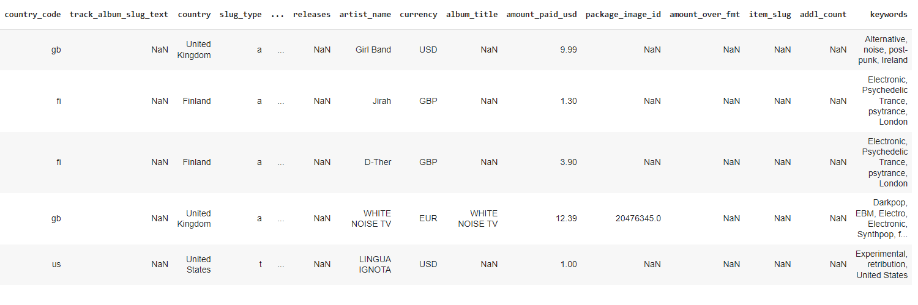
Data Processing & EDA
Combined the json files and joined with sales dataset on the url feature
Dropping irrelevant columns such as cover image url or artwork id
Filling in null/na values: ‘none’ for strings and 0 for ‘amount_over_fmt’ feature

Slide 6
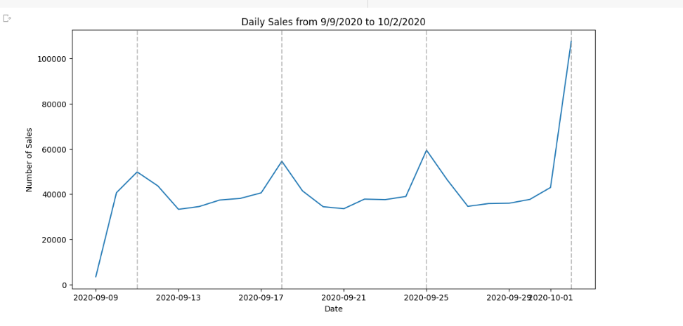
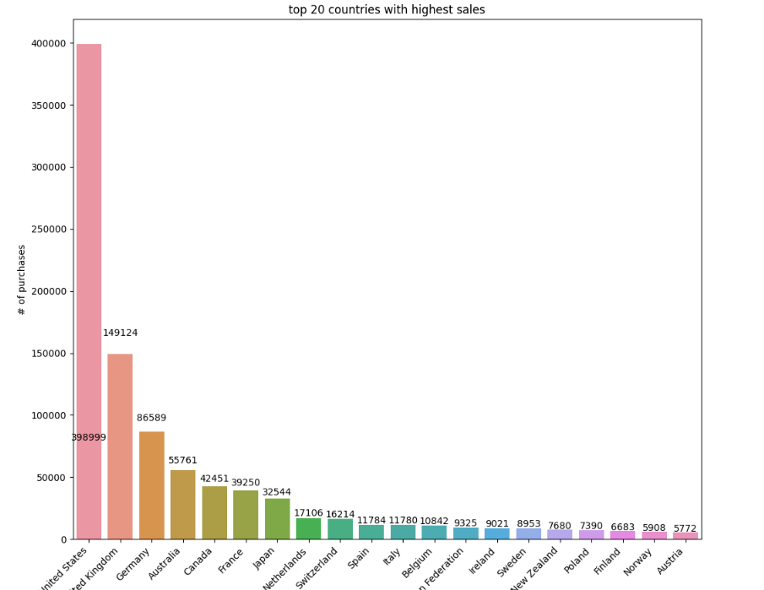
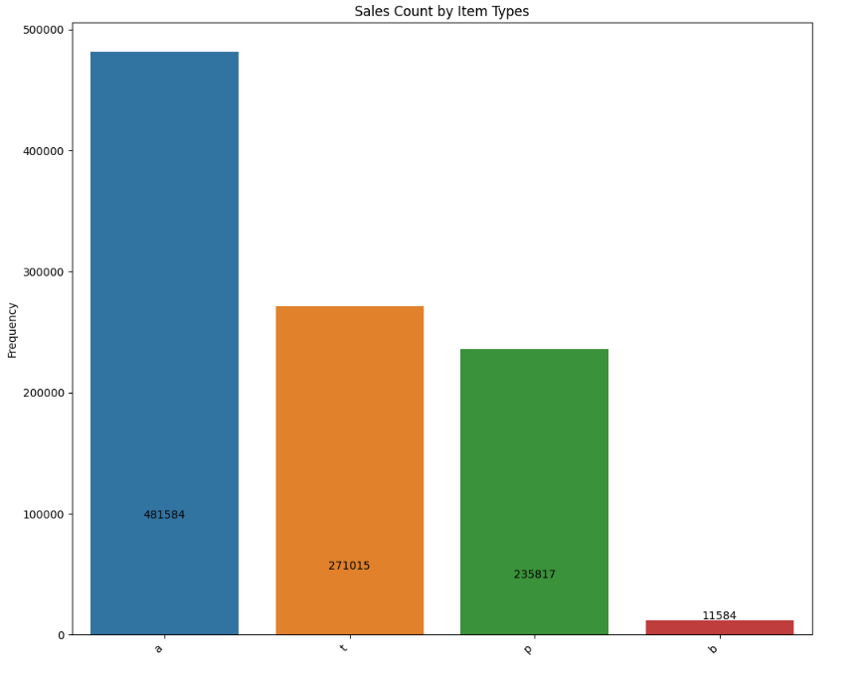
Data Processing & EDA(Cont.)
Time series graph shows peaks on Fridays
The US dominates sales distribution
Digital album is the most sold, physical sells around the same amount as individual track
(1)
(2)
(3)

Slide 7
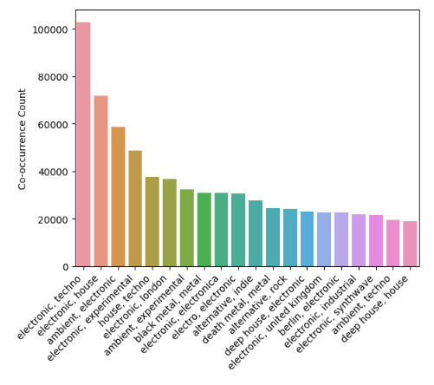
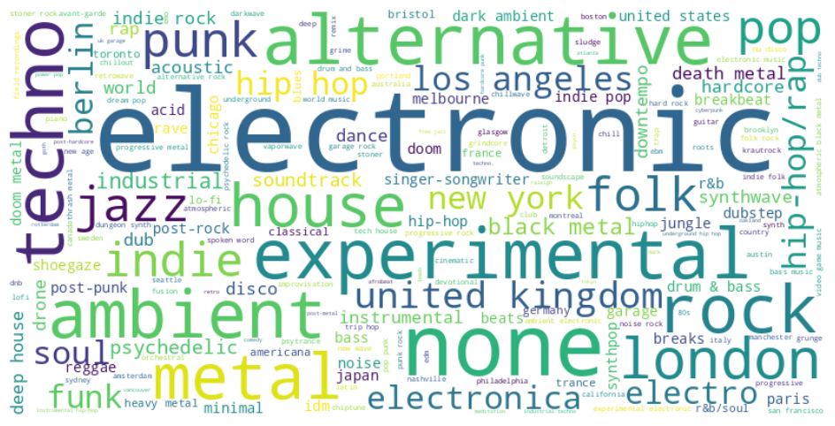
Data Processing & EDA (Cont.)
Music tagged as House, Techno, experimental and ambient are the top that seem to be trending
Further processing needs to be done, experiment with full text description

Slide 8
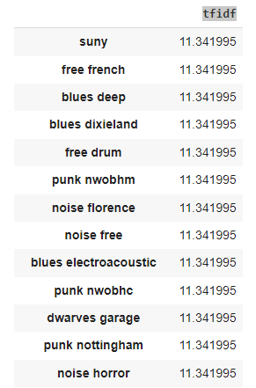
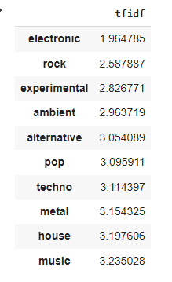
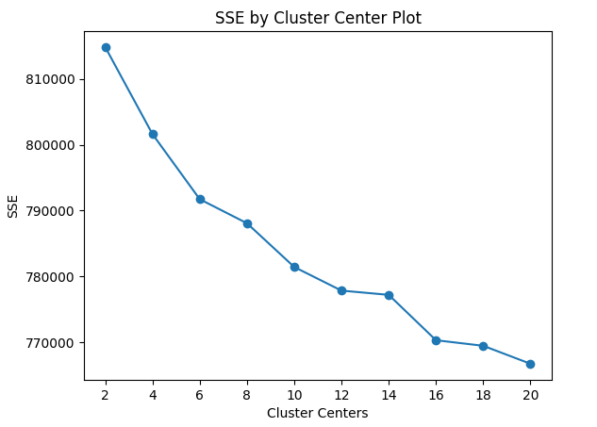
Unstructured Data Processing
Extracted and cleaned text description and music tags in order to create item categories
Performed TF-IDF(term frequency-inverse document frequency) to get keyword weights, tokenized into unigrams and bigrams
Tokens tf-idf encoded to be clustered, decided k=16 using Elbow Method

Slide 9
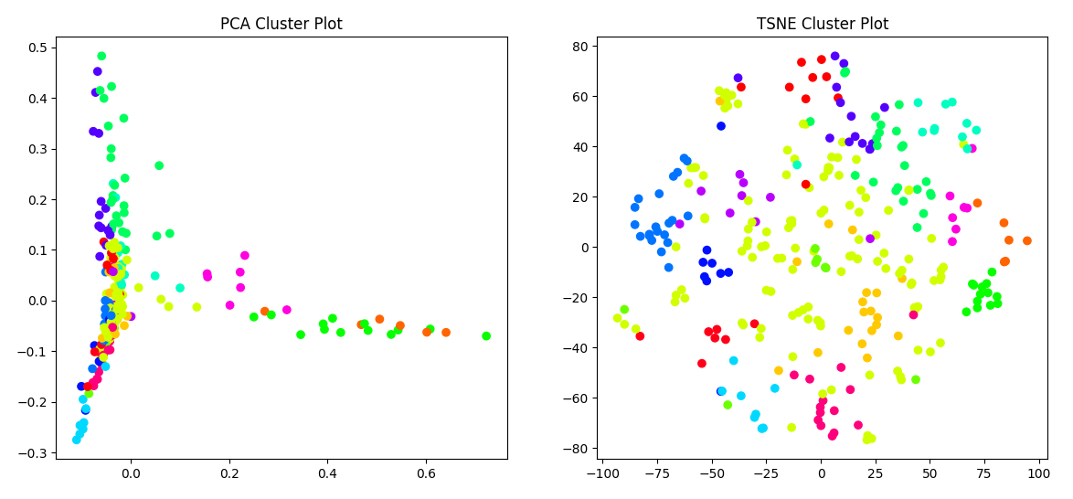
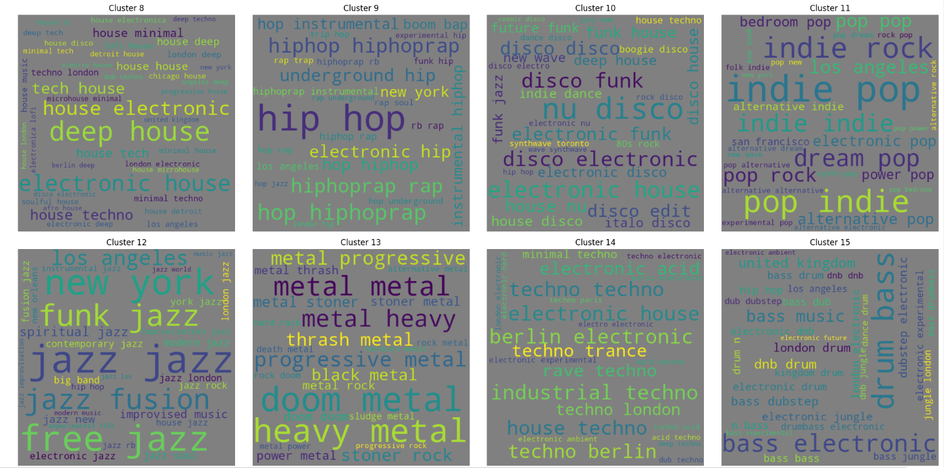
Unstructured Data Processing (Cont.)
Resulted in 16 categories
Wordcloud visualization indicates clusters are of different music styles
Average Silhouette Score is 0.135, leaves a lot of room for future improvement
16 styles of music are further condensed into 7 broad genre categories based on personal experience and Discogs.com categorization:
Cat 1: Rock (1 + 5 + 13 + 6 + 7)
Cat 2: folk, world (0)
Cat 3: electronic music (2 + 8 + 14 + 15)
Cat 4: Soul/funk (4 + 10)
Cat 5: hip-hop (9)
Cat 6: indie/pop (11)
Cat 7: jazz

Slide 10
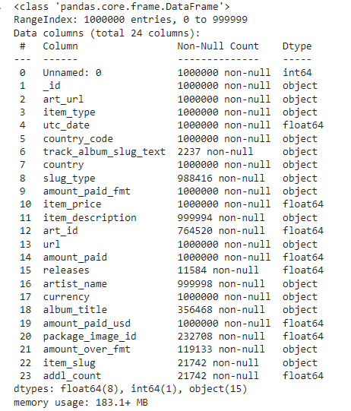
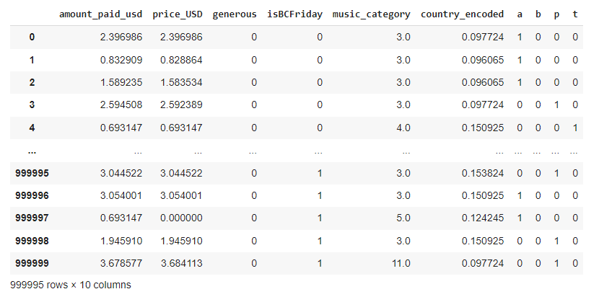
Feature Engineering & Selection
Convert item price to USD
One-hot encode item type
Target-mean encode country codes
Add labels from unstructured data clustering as music style category feature
Add generous (Y/N) column and isBCFriday(Y/N) features
Log scaled price and amount paid

Slide 11
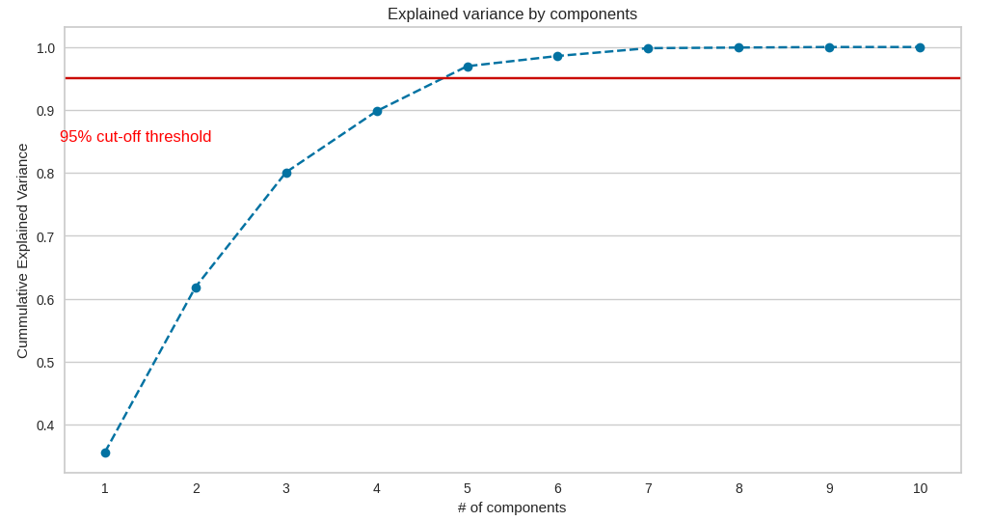
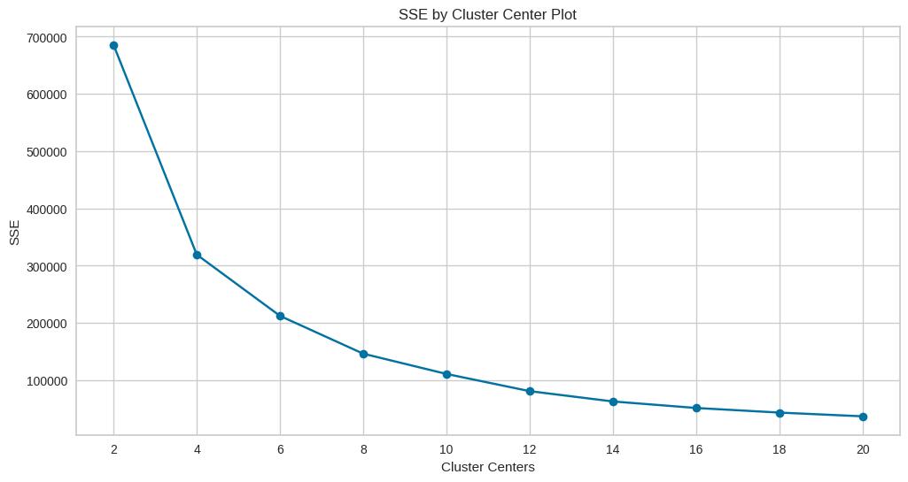
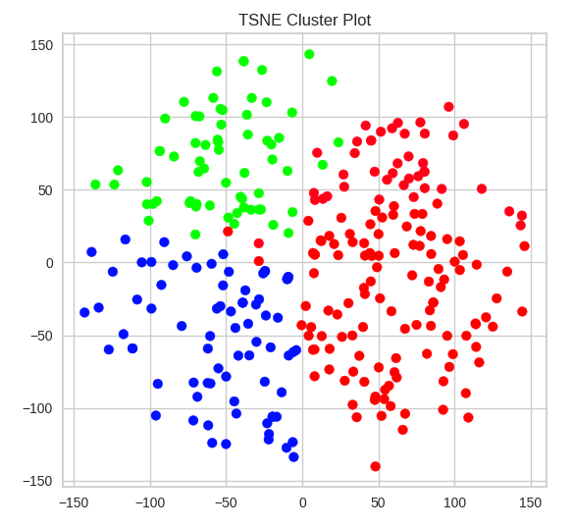
Clustering Transaction Dataset
Performed PCA to reduce dimensionality of data, 5 components would preserve at least 95% of variance in data
Used K-means clustering since I don’t have an outcome to predict and due to its ease of use and computationally efficient.
Used elbow method to determine optimal K=4
Resulting clusters have a Davies-Bouldin of 08.26, suggesting overlapping and points not being tight together

Slide 12
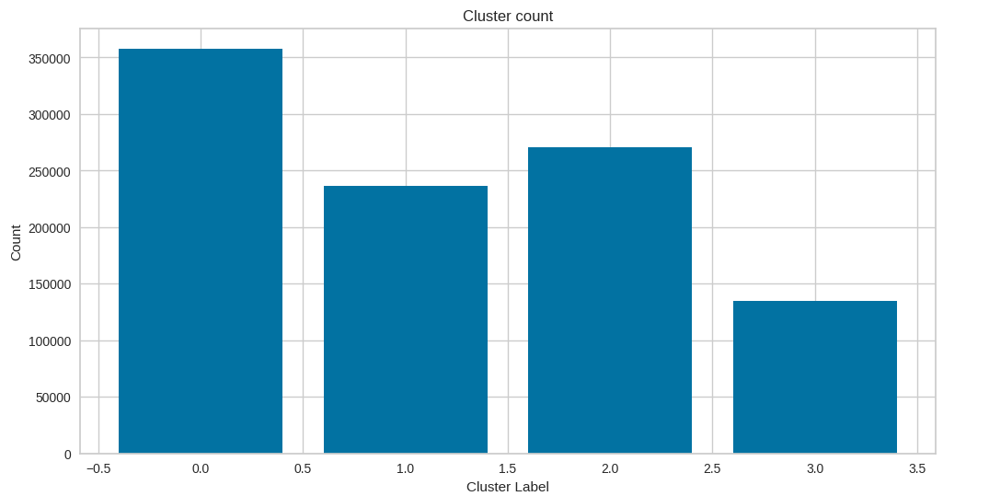
Results
K-means results in 4 clusters:
Cluster 0: about at least 36% of dataset
Cluster 1: about at least 24% of dataset
Cluster 2: about 26% of dataset
Cluster 3: abut 14% of dataset

Slide 13
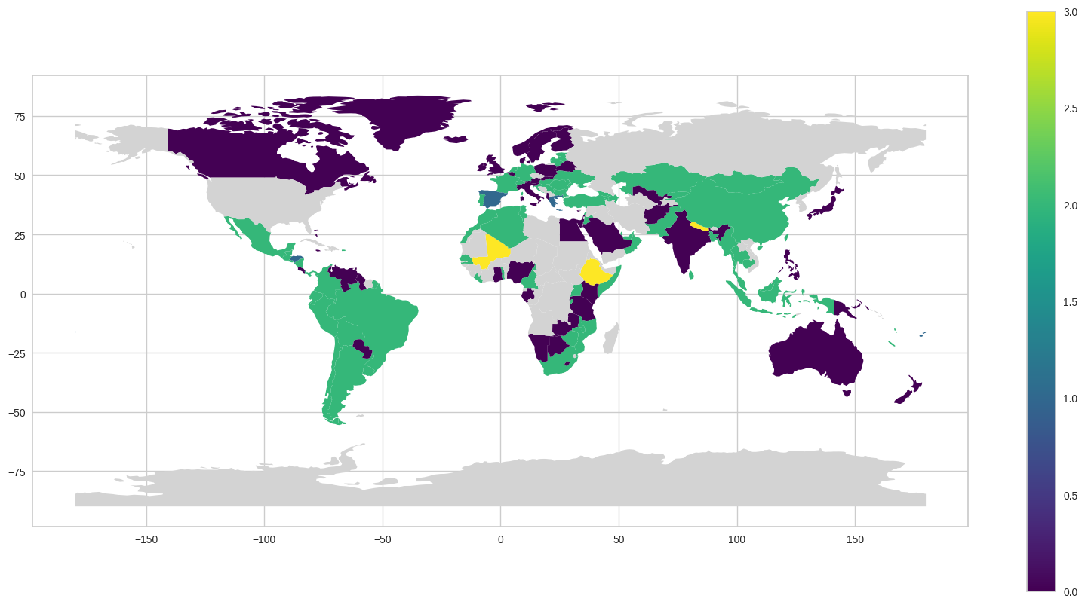
Results
Mapping transactions on the world map:
Majority of transactions: North America, Europe, Australia, Japan.
Top clusters in select geographical locations:
North America: Cluster 0
South America: Cluster 2
East and Southeast Asia: Cluster 2
Australia: Cluster 0

Slide 14
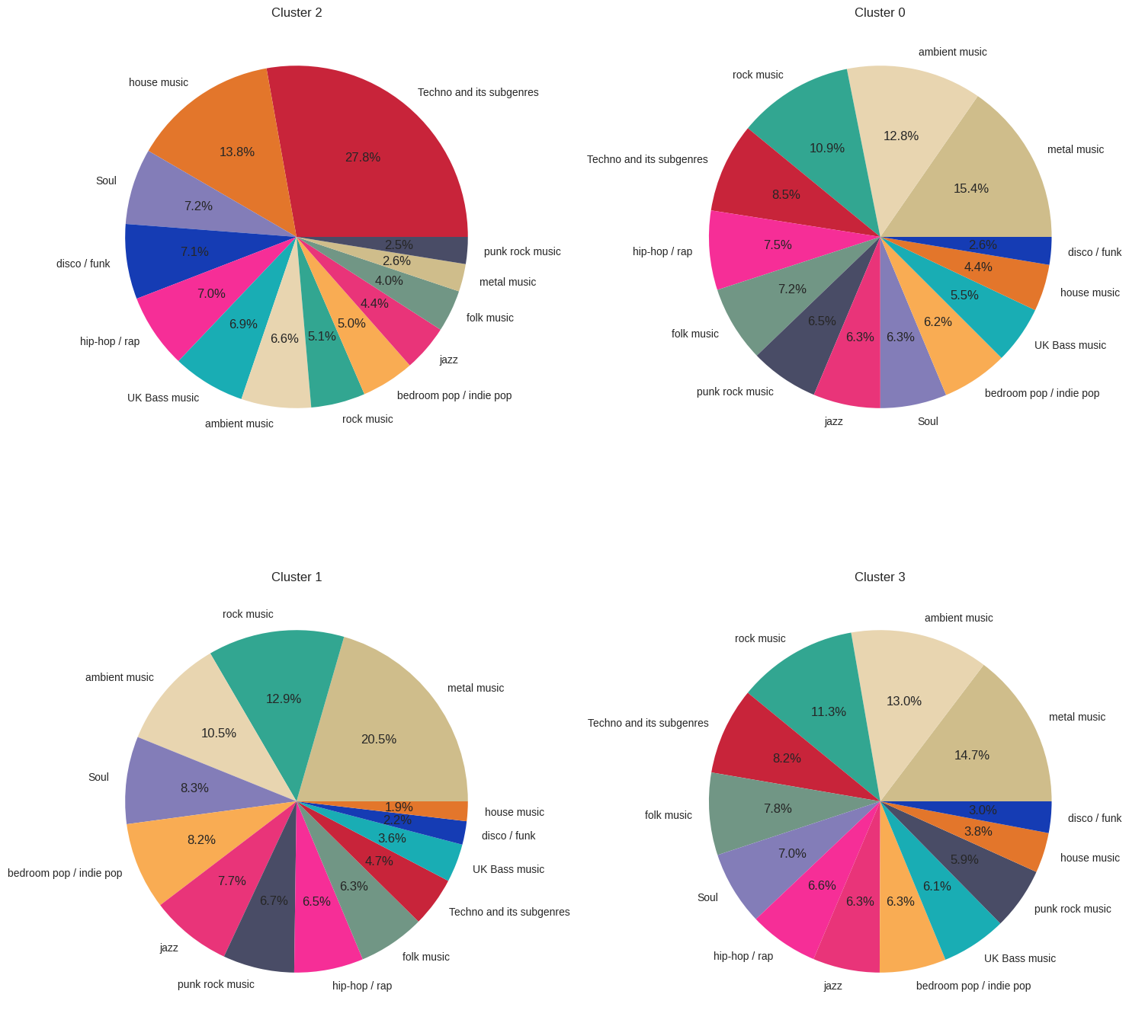
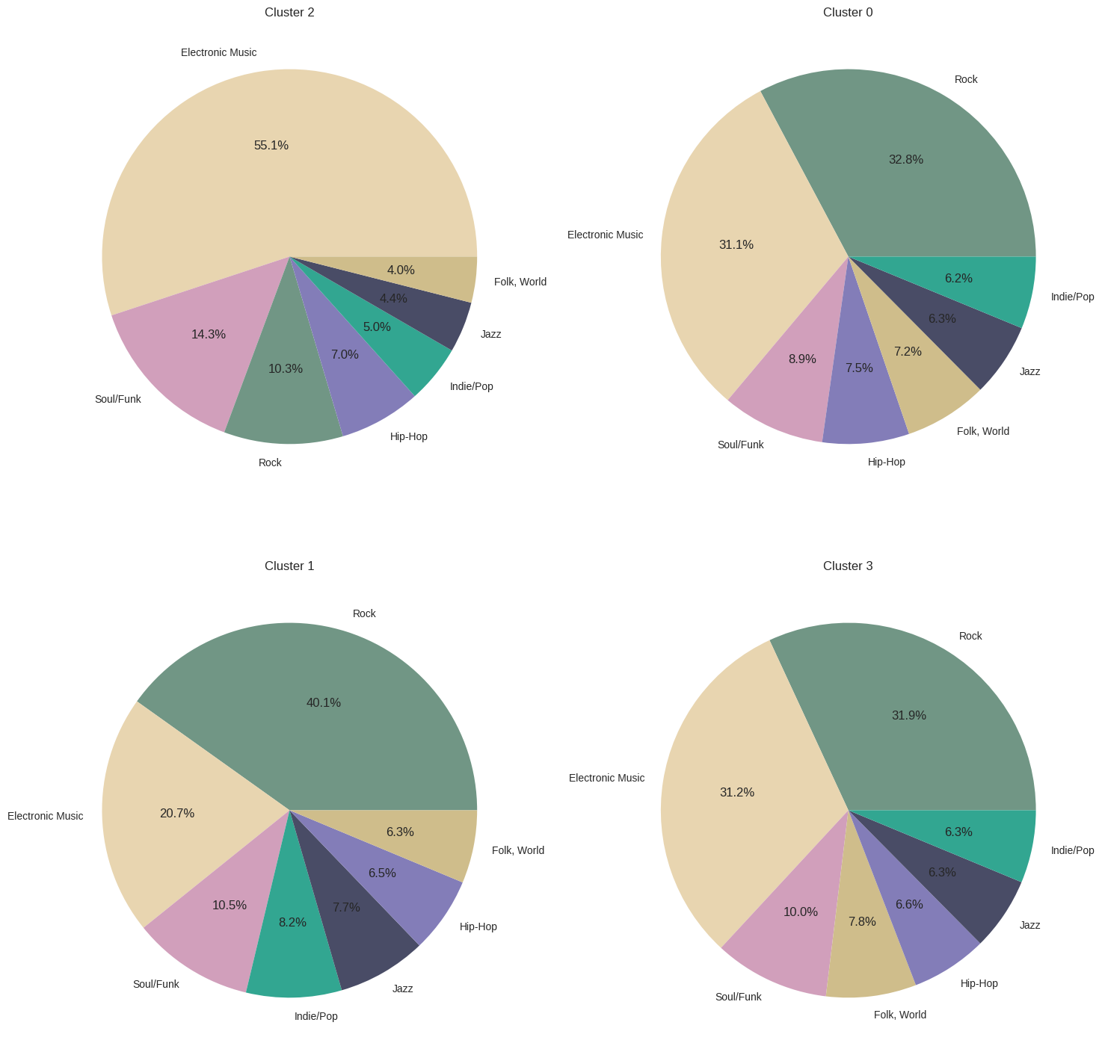
Results (Genre/Style distribution)
Notes:
Cluster 0:
Largest cluster (35% of the dataset)
Dominated by non-electronic music genres, with metal and rock being the most popular styles. Ambient music is also prominent.
Overall, a relatively even distribution of music styles within the cluster.
Cluster 1:
Non-electronic music accounts for 80% of the cluster, with rock being the dominant genre (40%). Electronic music represents 20% of the cluster.
Metal is the most popular style (20.5%), followed by rock. Other styles are evenly distributed.
Cluster 2:
Electronic music comprises the majority (55%) of the cluster, with a focus on 4-on-the-floor dance styles such as house and techno.
Disco and funk, which are foundational genres for house and techno, are also notable within this cluster.
Cluster 3:
Non-electronic music accounts for 69% of the cluster, with rock and electronic music being equally represented (31% each).
Similar to Cluster 1, rock and metal are popular styles, while other styles are evenly distributed.

Slide 15
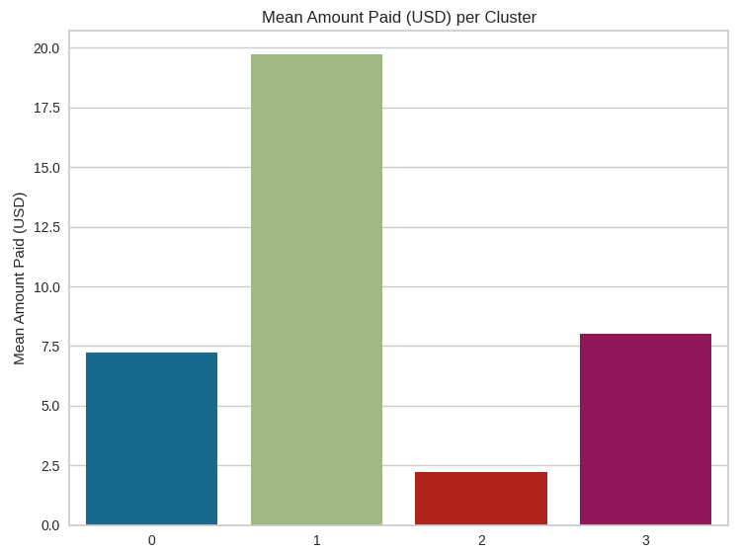
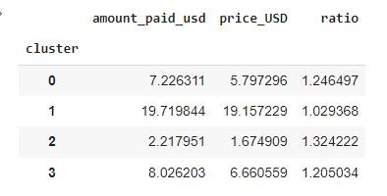
Results (Cont.)
Mean payment across the dataset: $8.93 USD. Cluster 1 has the highest mean payment at $19.72 USD, while Cluster 2 has the lowest.
Generosity of transactions: Cluster 0 accounts for 52% of the dataset’s generous transactions but ratio is equal to cluster 3 (accounts for 19.6%). Cluster 2 exhibits the least generosity (12.2%).
Bandcamp Fridays: Cluster 3 has the highest number of Bandcamp Friday transactions and is the most generous on these days. Cluster 2 has the lowest number of transactions, comparable to Cluster 1's Bandcamp Friday transactions.
Clusters | Generous | Ratio Gen : not Gen | Friday | Ratio Friday : Not Friday
0 | 62159 | 0.210 | 0 | 0
1 | 19056 | 0.0876 | 76179 | 0.475
2 | 14548 | 0.0567 | 60511 | 0.287
3 | 23370 | 0.210 | 134539 | 1

Slide 16
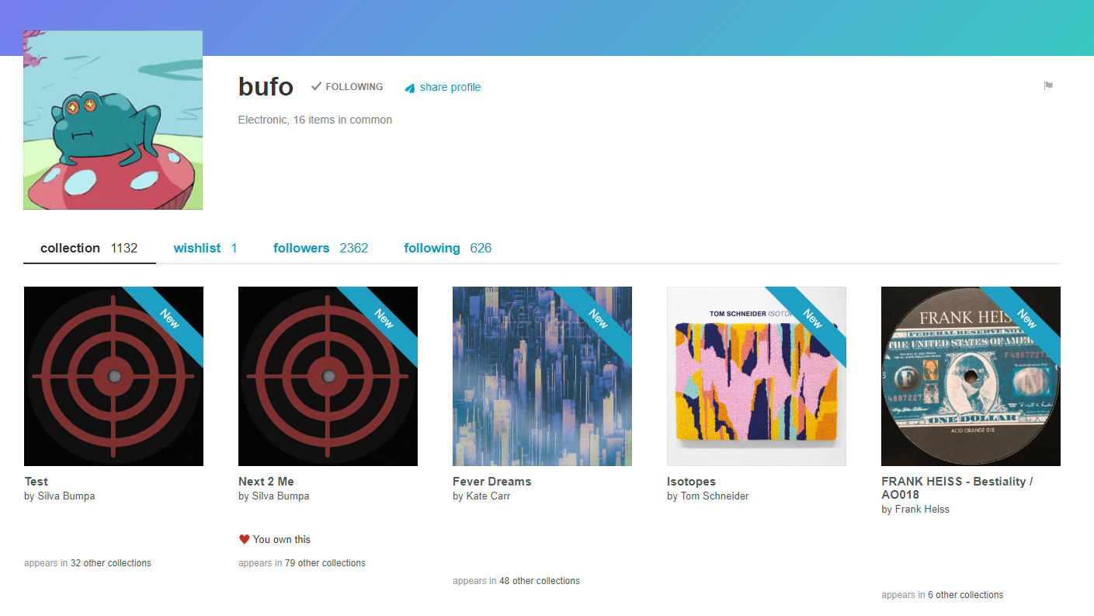
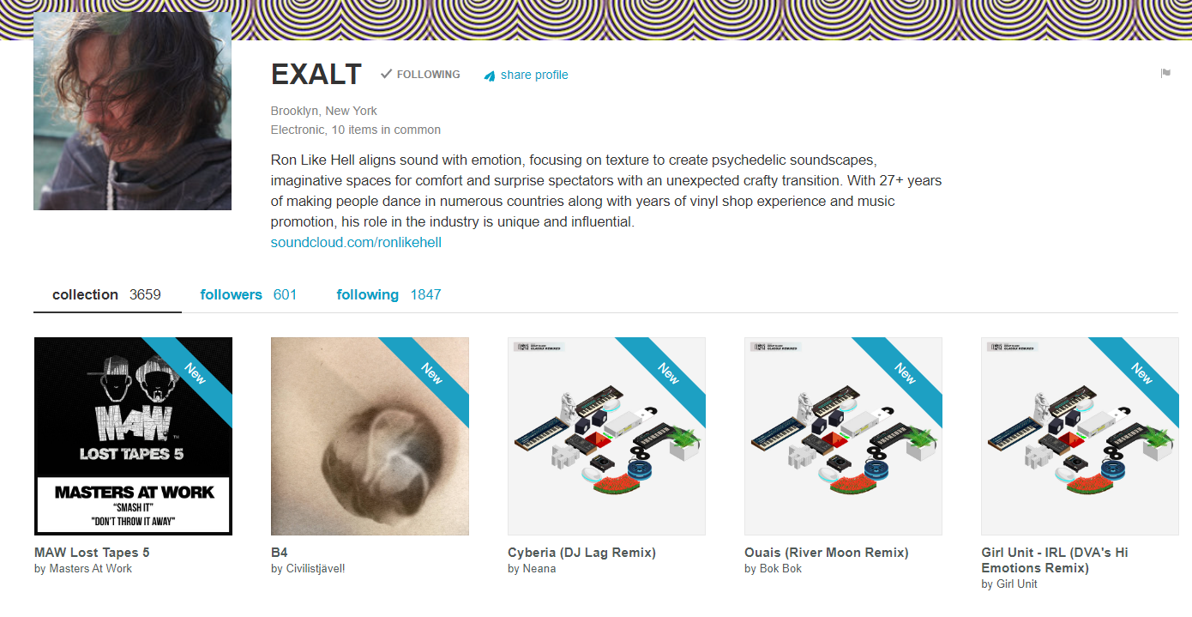
Conclusion: What Does This All Mean?
Examples of what some Group 2 userpages look like
The Clusters suggest 4 distinct user groups:
Group 0: Eclectic listeners with diverse music preferences, including electronic and rock genres, with a particular interest in ambient music, accounting for approximately 35% of the dataset.
Group 1: Enthusiasts of physical merchandise, or vinyl collectors primarily non-electronic music, with the highest mean payment amount at $19.72 USD.
Group 2: Dance music aficionados and DJs, predominantly purchasing electronic music with a focus on dance genres such as house and techno, often opting for individual tracks.
Group 3: Generous supporters mirroring Cluster 0's music preferences, but distinguished by their heightened generosity during Bandcamp Fridays, indicating a sub-group dedicated to financially supporting artists.
Notes:
Cluster 0: The Eclectic Listeners
Cluster 0, accounting for approximately 35% of the dataset, seems to encompass a broad range of Bandcamp users. This group shows diverse music preferences, with both electronic and rock genres constituting around 31% and 32% respectively of their purchases. Interestingly, ambient music, a sub-genre of electronic music, accounts for 12% of the purchases, highlighting a nuanced interest in the broader electronic genre. Metal music tops the popularity list in this cluster with a 15% share, hinting at an eclectic listener base.
Cluster 1: The Vinyl Collectors & Physical Merchandise Enthusiasts
Cluster 1 is dominated by non-electronic music purchases, with rock taking a significant 40% share. This cluster is characterized by its predilection for physical merchandise; 100% of the transactions involving physical merch belong to this group. Furthermore, this cluster registers the highest mean payment amount at $19.72 USD, indicative of the higher cost associated with physical items and the cluster's willingness to invest in such purchases.
Cluster 2: The Dance Music Aficionados and DJs
Cluster 2 shows a distinct leaning towards electronic music, more specifically dance music with Black-American lineage such as house and techno. The cluster is also characterized by purchases of individual tracks, hinting at a potential DJ community within this group.
Cluster 3: The Generous Supporters
Cluster 3 mirrors cluster 0 in terms of its diverse musical preferences but stands out due to its generous transactions and support for artists during Bandcamp Fridays. Despite its similarities with Cluster 0, Cluster 3's transactions on Bandcamp Fridays are significantly higher, suggesting a distinct sub-group within the wider Bandcamp user base committed to supporting artists financially.

Slide 17
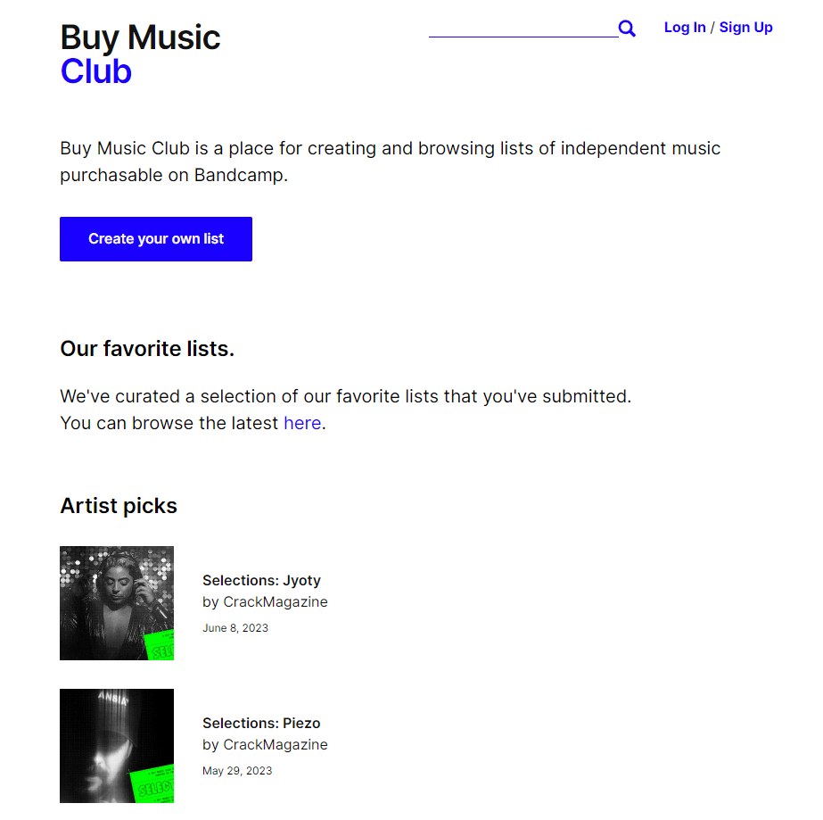
Conclusion (Cont.)
Cluster analysis reveals distinct user personas with unique music tastes, purchasing patterns, and levels of artist support:
Group 2: Electronic music enthusiasts, possibly DJs, prefer individual track purchases. Expanding standout tracks feature or incorporating lists such as that from buymusic.club could resonate well.
Group 0 and 3: Represent a wider user base. Cluster 3 shows strong support for artists, especially on Bandcamp Fridays. Enhancing interaction between fans and artists is recommended.
Group 1: Driven by physical merchandise transactions, potentially collectors and merch enthusiasts. Strategies focusing on limited editions, exclusive merch, or physical-only releases would attract this group
Notes:
This cluster analysis provides a multi-dimensional look into Bandcamp's user behavior, pointing towards varying user personas with unique music tastes, purchasing patterns, and levels of artist support. Each cluster embodies a distinct user segment with tangible implications for Bandcamp's marketing and user engagement strategies.
Cluster 2, likely constituting electronic music enthusiasts and possibly DJs, showcases a preference for individual track purchases. This suggests that a recommendation system highlighting standout tracks or curated playlists could resonate well with this group.
Clusters 0 and 3 appear to represent a wider Bandcamp user base, with Cluster 3 showing a strong inclination towards supporting artists, particularly on Bandcamp Fridays. Enhanced communication of artist support initiatives, like Bandcamp Fridays, could be an effective strategy to engage this user segment further.
Cluster 1 seems to be driven by physical merchandise transactions, potentially comprising collectors and merch enthusiasts. Strategies focusing on limited edition releases, exclusive merch, or physical-digital bundles could be an attractive proposition for this cluster.

Slide 18
Shortcomings & Possible Future Work
Despite these insights, the analysis presents several limitations:
The relatively low silhouette score of 0.135 suggests potential overlap between clusters.
The Davies-Bouldin score of 0.826 indicates scope for improving the cluster separation and compactness.
The 'tagless' items, which were grouped into a single category, accounted for a significant portion of the dataset and could be further refined.
Text data, due to computational limitations and my personal technical shortcoming, a full exploration of the keyword tags together with description text weren’t possible. A more granular analysis plus implementation of sentiment analysis of the full text description might reveal additional dimensions and nuances to users' preferences and purchasing behaviors. Future research could also benefit from improved data preprocessing and categorization of genres to manage the high dimensionality often associated with music genre data.

